Slide 1


CS348 SOFTWARE GROUP PROJECT-4
Quick Eats
PREPARED
BY :- DHARMJEET(D22DCS159)
DHRUMIL(D22DCS160)
VANDAN(D22DCS161)
Guided by :-
Gaurang Patel

Slide 2
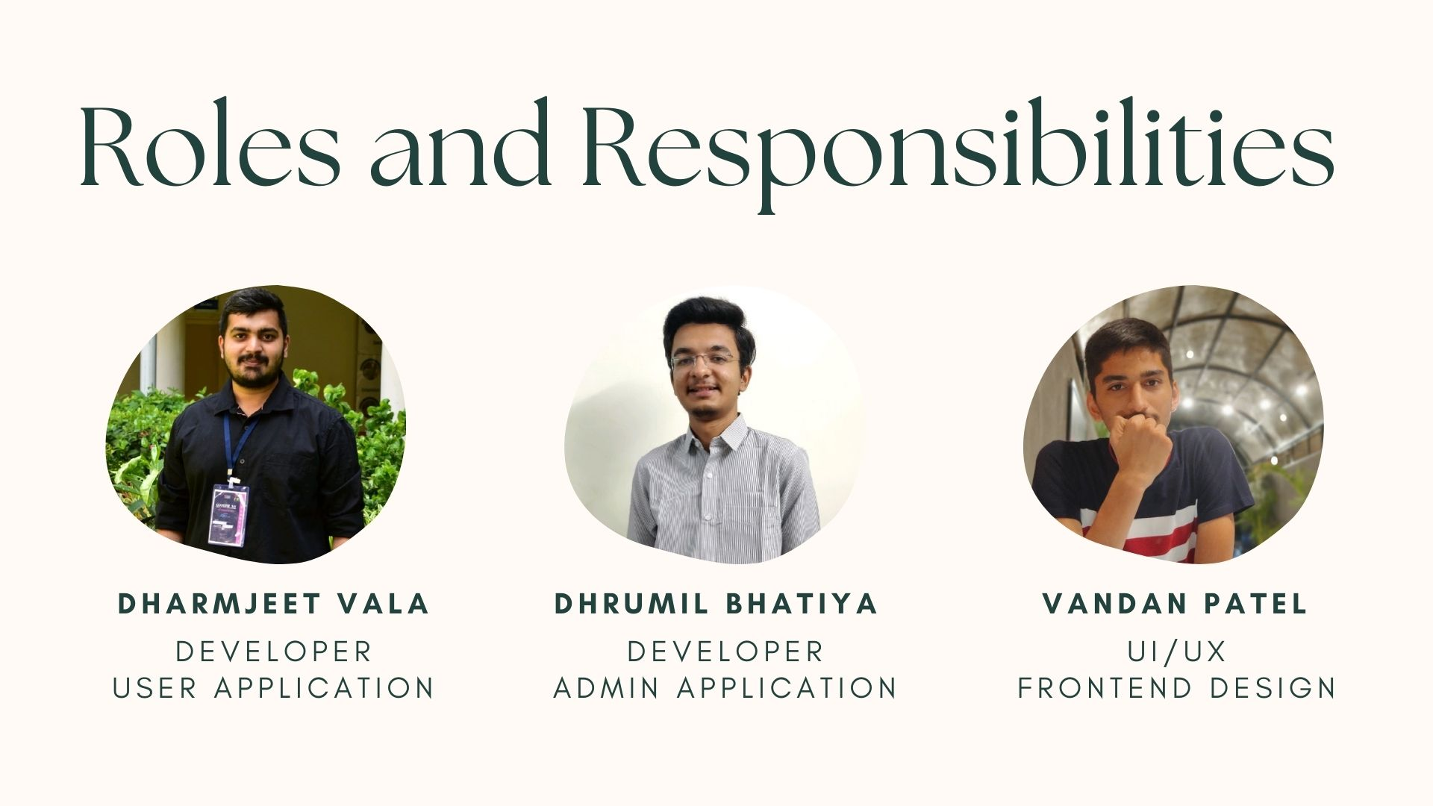

Slide 3
Topics to be covered:-
Problem statement
Project Objectives
Project description
Process Model
Current System and its limitation
Technical stack(technology to be used)
Gantt Chart and System Flow Chart
Limitation and future scope
Conclusion

Slide 4
Problem statement
In today's fast-paced world, people frequently struggle to find a simple, efficient, and user-friendly platform for purchasing food online. Existing meal delivery apps may lack specific features or be overly complex, causing customer frustration. Furthermore, restaurants may face difficulty in properly maintaining menu items and processing orders. As a result, there is a need for a comprehensive Online Food Ordering application that meets the needs of both users and restaurant owners, offering a streamlined and delightful experience for ordering and delivering a wide variety of tasty meals.

Slide 5
Project Objectives:
Improve the application's user interface for a more intuitive and user-friendly experience.
Streamline the order processing system to ensure timely and accurate deliveries.
Provide restaurants with tools for efficient menu management, inventory tracking, and seamless order processing.

Slide 6
Project Description:
A Wave Food apps for admin and user using java, XML and Firebase
User application offers ordering of food from user’s favorite restaurant and at specific quantity and discounted price
Admin application: Empowers administrators to manage restaurants, review user orders, and take necessary actions;

Slide 7
Process Model:
Agile methodology chosen for its iterative approach, fostering flexibility and adaptability to evolving project requirements.
Continuous user feedback integrated into development cycles ensures alignment with stakeholder needs and enhances product quality.
Incremental delivery of features enables early value realization and facilitates timely adjustments based input

Slide 8



Current Systems and limitation:
There are similar apps like Uber eats, Door Dash, Grubhub, etc., for online food ordering etc.
These apps lack for UI design and responsiveness

Slide 9







Technical stack(technology to be used):
Hardware:
Software:
Editor:
Browser:
Java
XML
Firebase
Chrome
Android Studio
Laptop
Brave

Slide 10
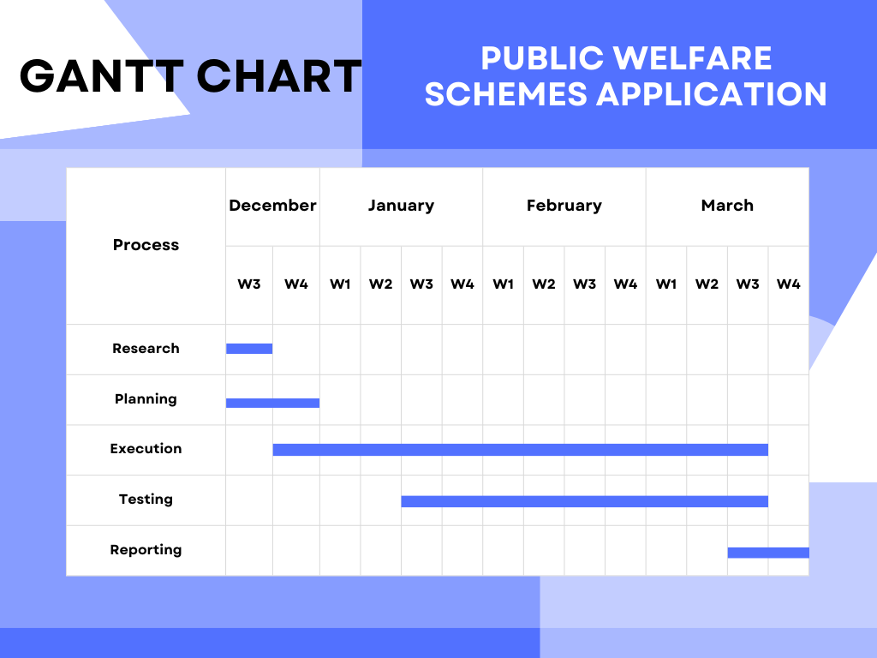
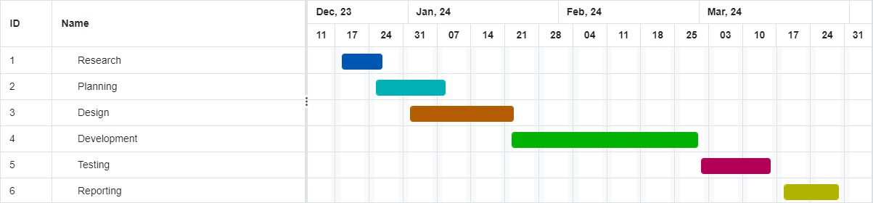

Slide 11
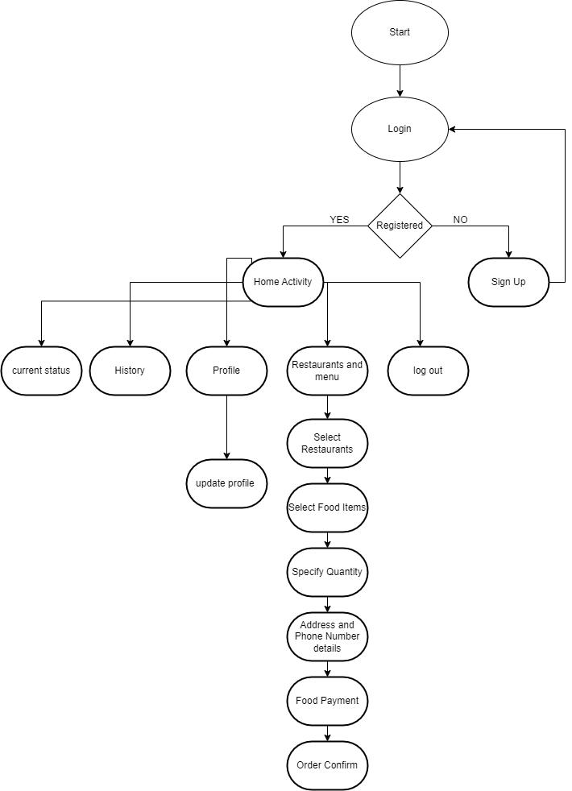
User app:
System Flow Chart

Slide 12
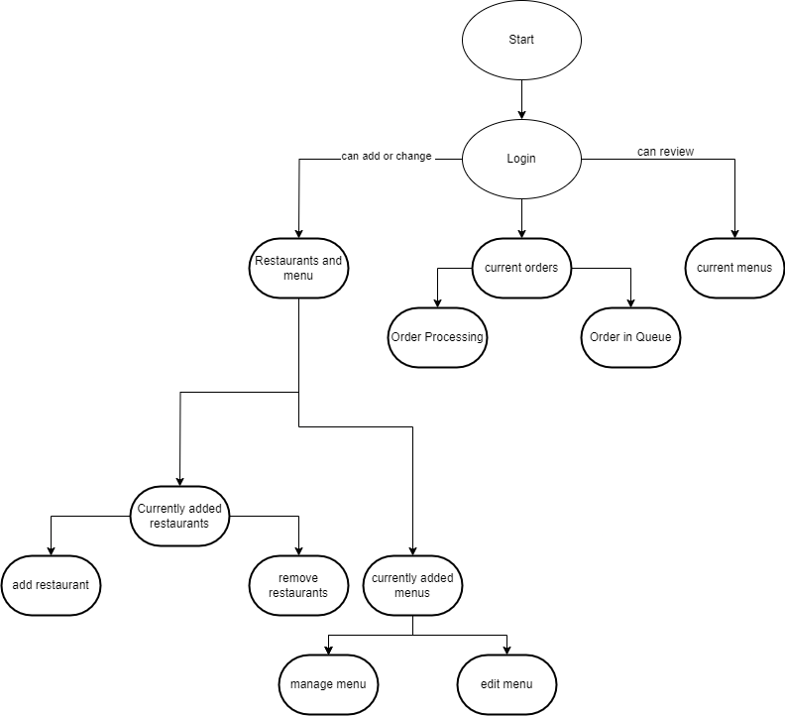
Admin app:

Slide 13
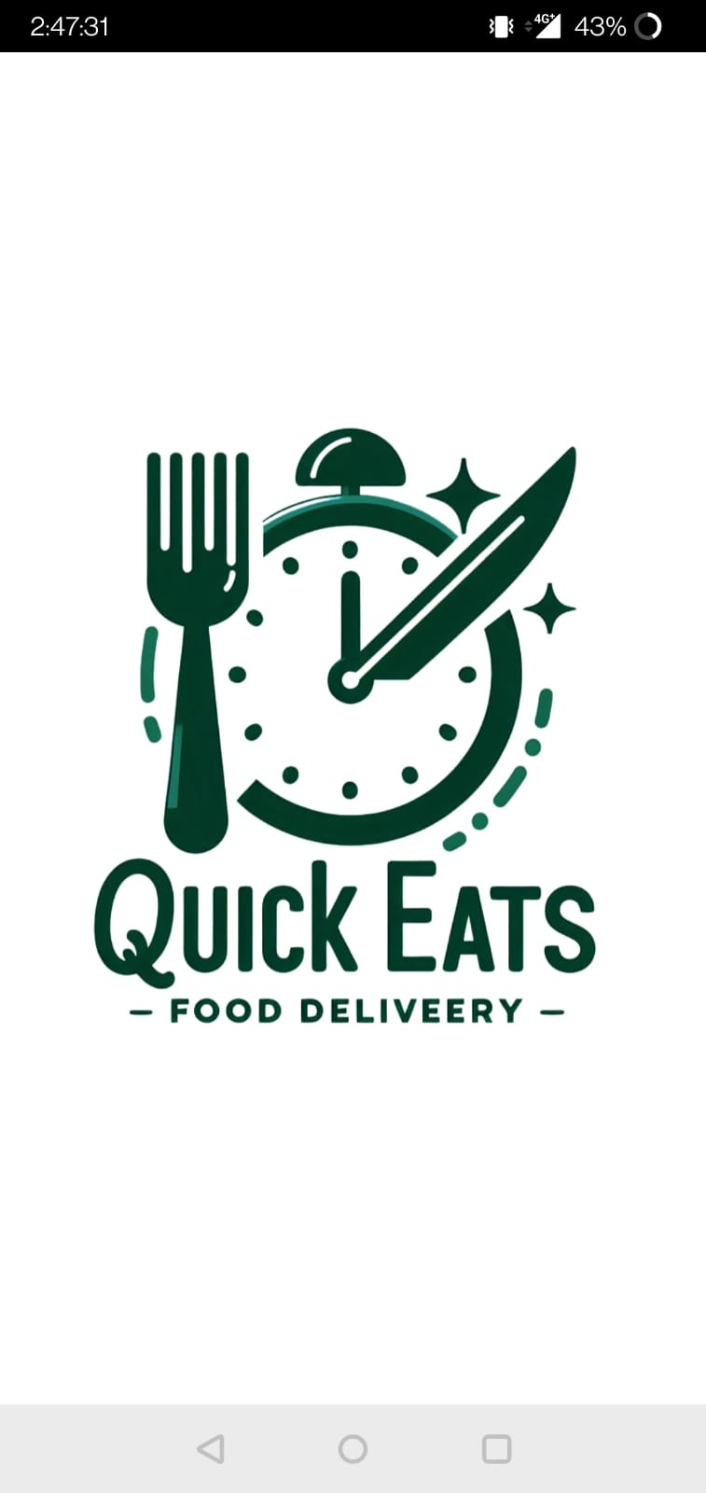
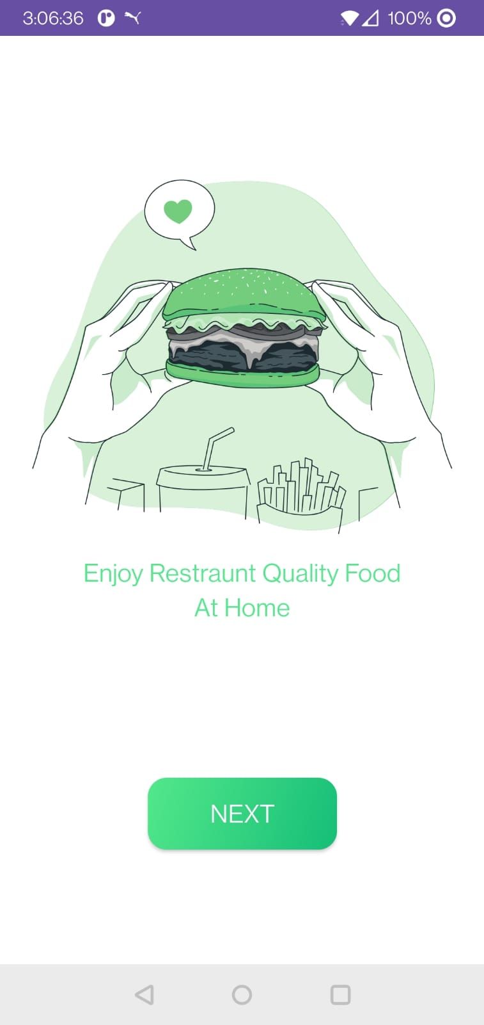
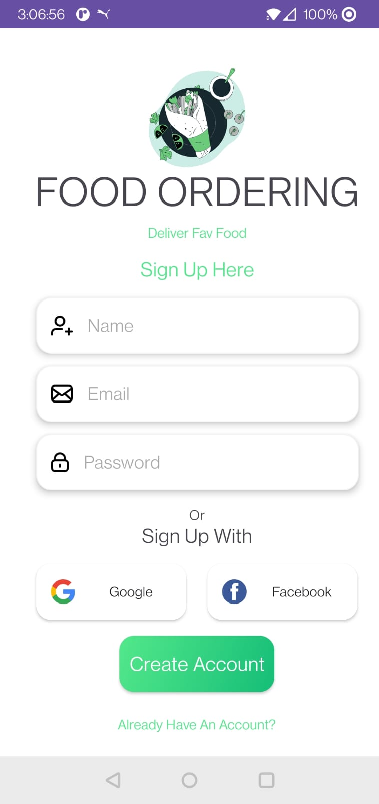
User app:
Snapshots :

Slide 14
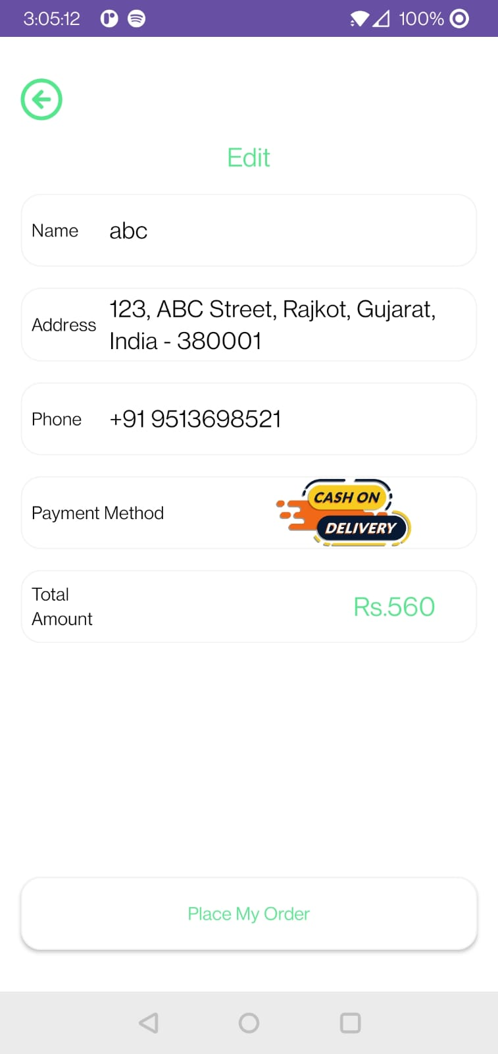
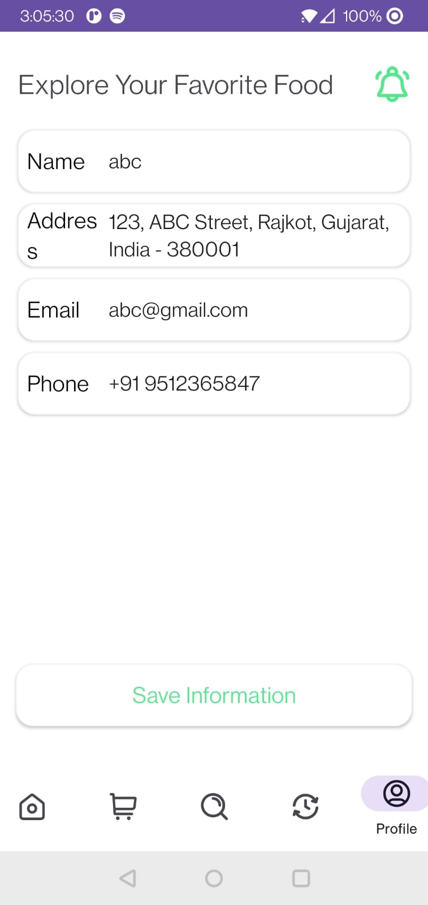
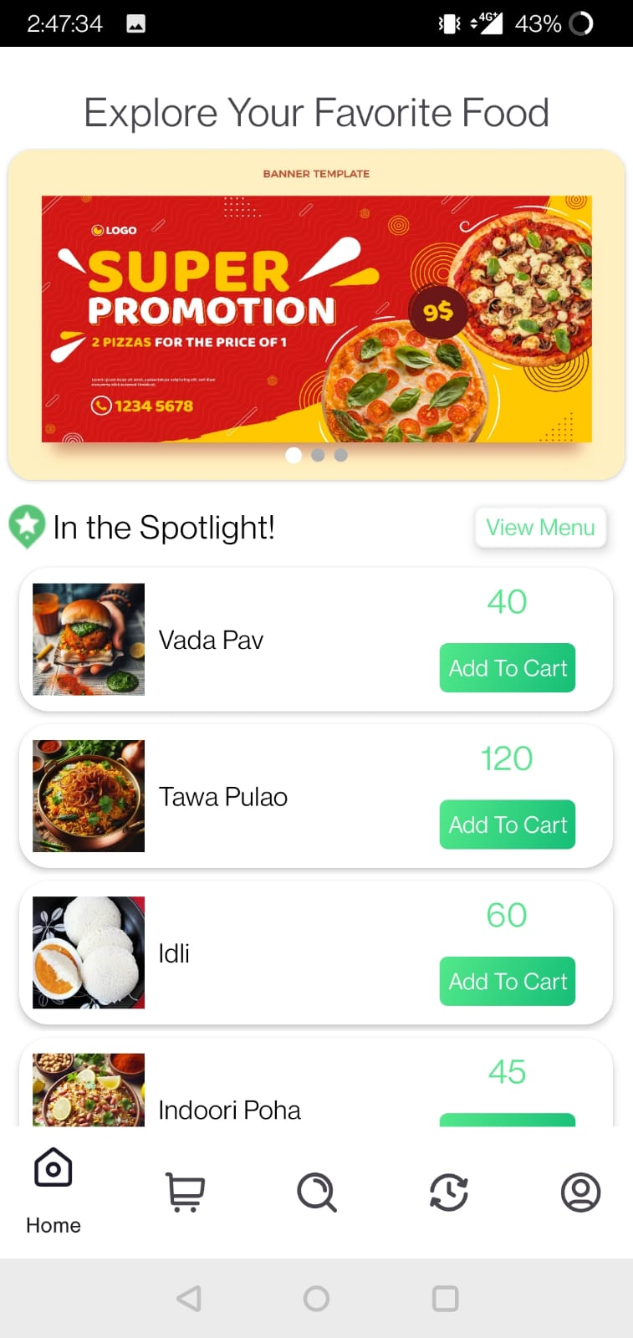
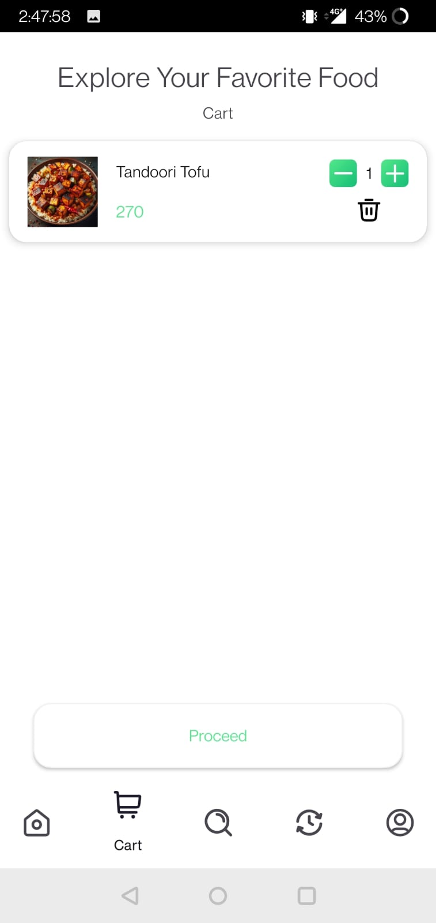
Continue…

Slide 15
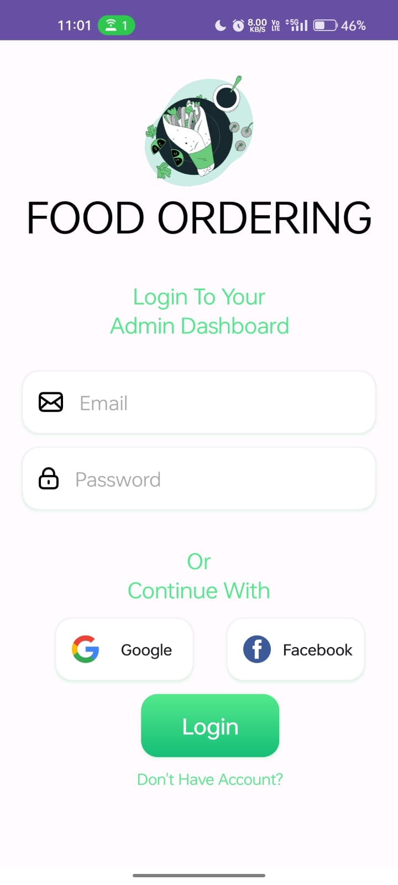
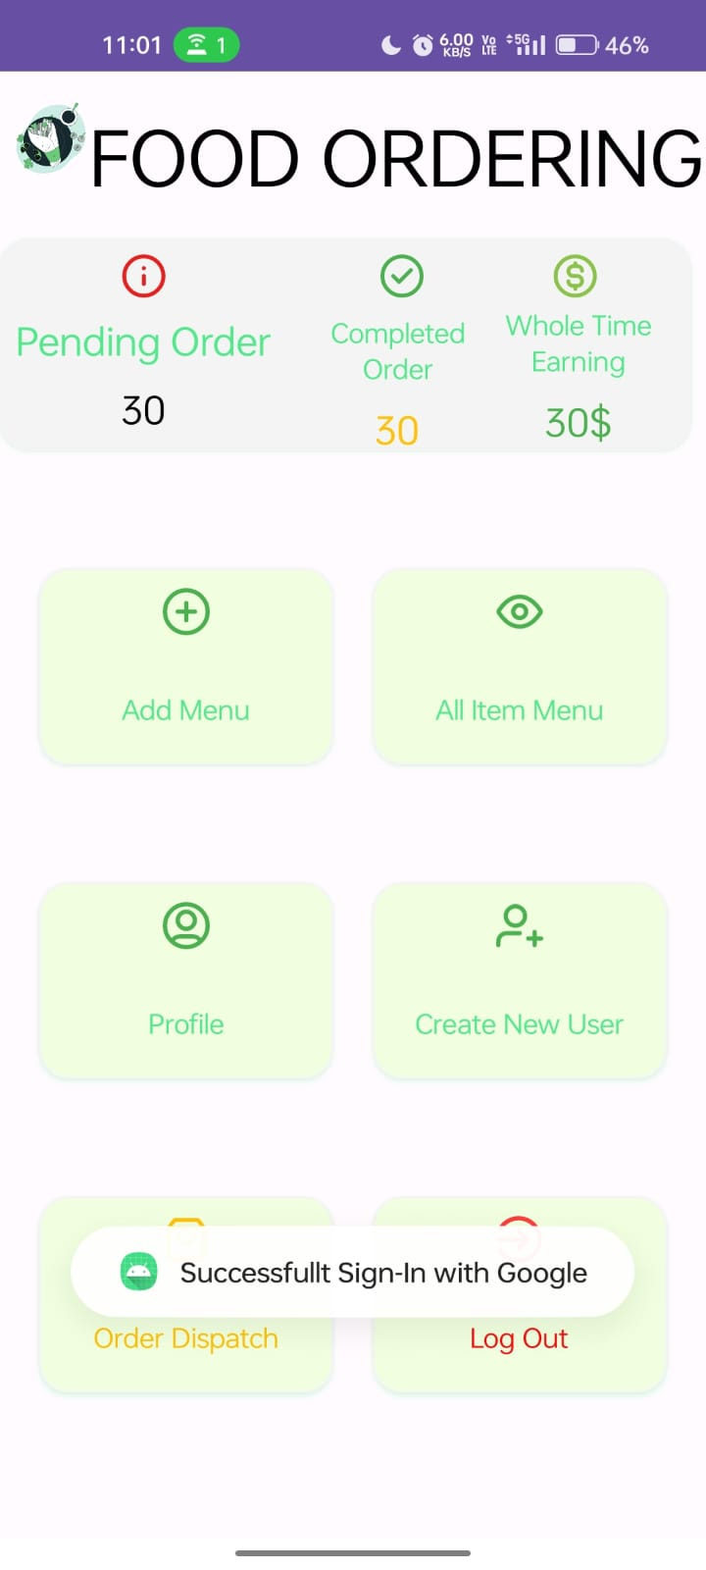
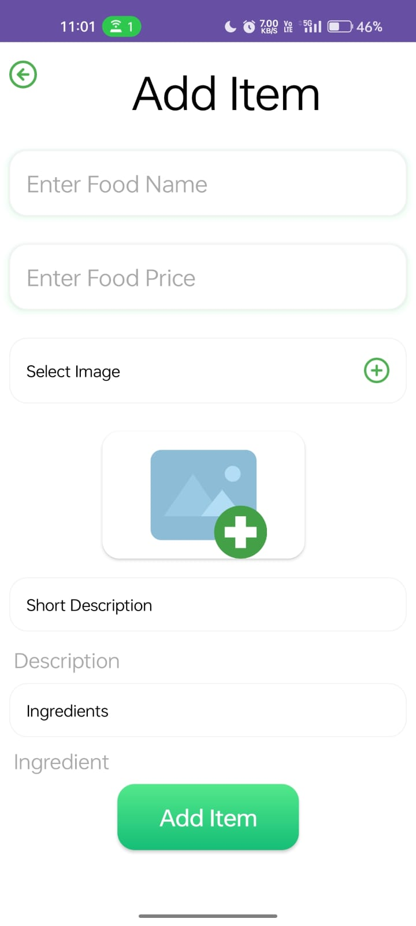
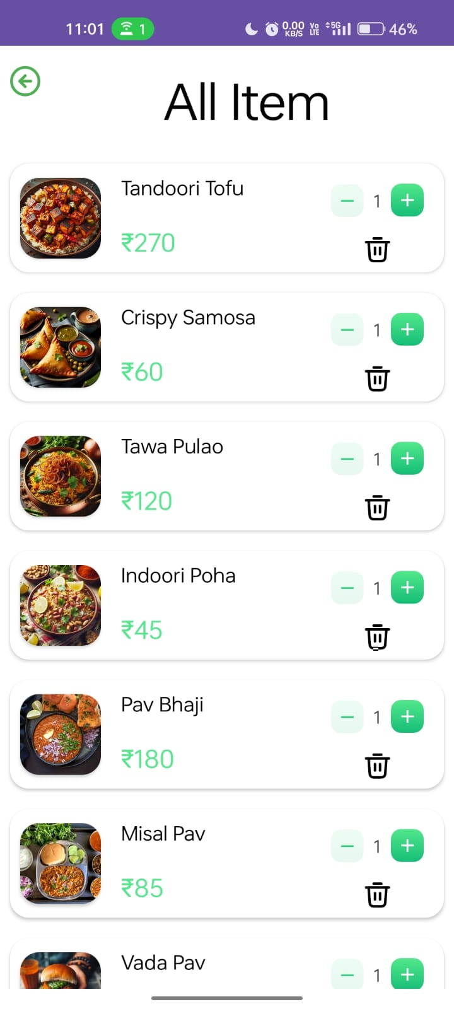
Admin app:

Slide 16
Limitations and future scope:
Analysis of all the order in admin app whether approved or rejected for User.
Payment method integration at admin side.
History of order and transactions implementation for admin application

Slide 17
Conclusion:
This project aims to revolutionize access to online food ordering through a user-friendly mobile application, enhancing transparency and efficiency in food ordering. By leveraging modern technology and efficient processes, it endeavors to bridge the gap between citizens in need and available restaurants

Slide 18
References:
https://www.youtube.com/watch?v=HyU4vkZ2NB8&list=PLjVLYmrlmjGdDps6HAwOOVoAtBPAgIOXL, last accessed 29/02/2024
https://developer.android.com/about?gclid=Cj0KCQjwoeemBhCfARIsADR2QCsafgPMKOkXsSGCSEWN95vmFuDIpQnkCf2i_acDSYY8O7UOEj4A_AEaAr6dEALw_wcB&gclsrc=aw.ds, last accessed 29/02/2024
https://chat.openai.com/, last accessed 29/02/2024
https://stackoverflow.com//, last accessed 29/02/2024
https://abhiandroid.com/, last accessed 29/02/2024

Slide 19
Thank you!
Any questions?

